Slide 1
Apollonius
262 - 190 BC
Journey Through Genius Pp 116
Notes:
Apollonius was another post-Archimedean mathematician worth studying
Another contemporary of Archimedes
He travelled to Alexandria to work on his masterpieces, the Conics
The ellipses, parabola, and hyperbola
The Conics was written in eight books, organized in the Euclidean fashion
The first four giving general information, the last four giving some special cases
Book 8 has been lost entirely
When Johann Kepler (1571-1630) had his groundbreaking theory that planets travel in elliptical patterns around the sun, the importance of the conics was reaffirmed
A century later the British scientist Edmund Halley devoted years of his life preparing the definitive edition of the Conics
It stands as important as Euclid’s Elements and Archimedes’ work as one of the “landmarks of Greek mathematics”
**insert excerpts from Conics**
**insert diagrams of ellipses, parabola, hyperbola**

Slide 2
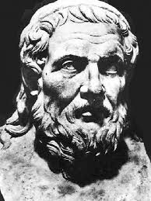
Apollonius
Another contemporary of Archimedes
Travelled to Alexandria to work on his masterpiece, the Conics
Ellipses, parabola, hyperbola
Written in the Euclidean style, in eight books, the first four giving general information, the last four giving special cases
When John Kepler (1571-1630) had his groundbreaking theory that the planets travel in elliptical patterns, the importance of the Conics was again recognized

Slide 3
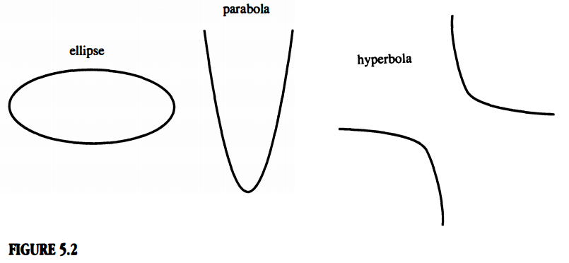
His work was revolutionary in the field of analytic geometry, highly recommend reading about his work and Conics

